Slide 1
Sequence Generation
Hung-yi Lee
李宏毅
Notes:
K. Greff, R. K. Srivastava, J. Koutník, B. R. Steunebrink, J. Schmidhuber, "LSTM: A Search Space Odyssey," in IEEE Transactions on Neural Networks and Learning Systems, 2016
Rafal Józefowicz, Wojciech Zaremba, Ilya Sutskever, “An Empirical Exploration of Recurrent Network Architectures,” in ICML, 2015
https://www.cs.toronto.edu/~graves/preprint.pdf
Diluted RNN

Slide 2
Outline
RNN with Gated Mechanism
Sequence Generation
Conditional Sequence Generation
Tips for Generation

Slide 3
RNN with Gated Mechanism
Notes:
http://www.thespermwhale.com/jaseweston/ram/

Slide 4

Recurrent Neural Network
h and h’ are vectors with the same dimension
Given function f: $h^{′},y=f\left(h,x\right)$
y¹
y²
y³
h⁰
f
h¹
f
h²
f
h³
……
x¹
x²
x³
No matter how long the input/output sequence is, we only need one function f

Slide 5



Deep RNN
$$h^{′},y=f_{1}\left(h,x\right)$$
$$b^{′},c=f_{2}\left(b,y\right)$$
$$…$$
…
…
…
c¹
c²
c³
b⁰
f₂
b¹
f₂
b²
f₂
b³
……
y¹
y²
y³
h⁰
f₁
h¹
f₁
h²
f₁
h³
……
x¹
x²
x³

Slide 6



Bidirectional RNN
$$h^{′},a=f_{1}\left(h,x\right)$$
$$b^{′},c=f_{2}\left(b,x\right)$$
x¹
x²
x³
b⁰
f₂
b¹
f₂
b²
f₂
b³
c¹
c²
c³
y¹
y²
y³
$$y=f_{3}\left(a,c\right)$$
f₃
f₃
f₃
a¹
a²
a³
h⁰
f₁
h¹
f₁
h²
f₁
h³
x¹
x²
x³
Notes:
To determine yi, you have to consider a lot ……
There are more different types in the slides of HW3.

Slide 7


Naïve RNN
Given function f: $h^{′},y=f\left(h,x\right)$
y
h'
W^{h}
h
W^{i}
x
$$+$$
$$=σ\left( \right)$$
h
f
h'
y
Wº
h'
$$=σ\left( \right)$$
x
softmax
Ignore bias here

Slide 8
LSTM
y^{t}
LSTM
c^{t}
y^{t}
c^{t-1}
Naive
h^{t}
h^{t}
h^{t-1}
h^{t-1}
x^{t}
x^{t}
c changes slowly
c^{t} is c^{t-1} added by something
h changes faster
h^{t} and h^{t-1} can be very different

Slide 9
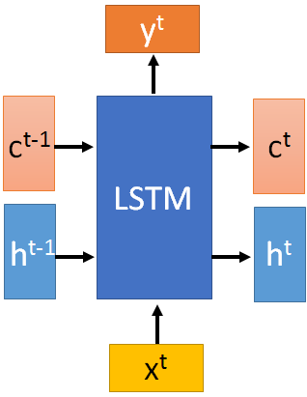




x^{t}
z
W
$$=tanh\left( \right)$$
h^{t-1}
c^{t-1}
x^{t}
z^{i}
W^{i}
$$=σ\left( \right)$$
h^{t-1}
Input
gate
x^{t}
z^{f}
W^{f}
$$=σ\left( \right)$$
h^{t-1}
z^{f}
z^{i}
z
zº
forget
gate
x^{t}
zº
Wº
$$=σ\left( \right)$$
h^{t-1}
x^{t}
h^{t-1}
output
gate
Notes:
Identiy
C is vector

Slide 10

x^{t}
z
W
h^{t-1}
$$=tanh\left( \right)$$
c^{t-1}
c^{t-1}
diagonal
“peephole”
zº
z^{f}
z^{i}
obtained by the same way
z^{f}
z^{i}
z
zº
h^{t-1}
x^{t}
Notes:
Identiy
C is vector

Slide 11








y^{t}
c^{t-1}
c^{t}
$$⨀$$
$$＋$$
$$⨀$$
$$c^{t}=z^{f}⨀c^{t−1}$$
$$+z^{i}⨀z$$
$$⨀$$
$$h^{t}=z^{o}⨀tanh\left(c^{t}\right)$$
z^{f}
z^{i}
z
zº
$$y^{t}=σ\left(W^{′}h^{t}\right)$$
h^{t-1}
x^{t}
h^{t}
Notes:
Identiy
C is vector

Slide 12








LSTM
y^{t}
y^{t+1}
c^{t-1}
c^{t}
c^{t+1}
$$⨀$$
$$＋$$
$$⨀$$
$$⨀$$
$$＋$$
$$⨀$$
$$⨀$$
$$⨀$$
z^{f}
z^{i}
z
zº
z^{f}
z^{i}
z
zº
h^{t+1}
h^{t-1}
x^{t}
h^{t}
x^{t+1}
Notes:
https://arxiv.org/pdf/1412.3555.pdf
Identiy
C is vector

Slide 13
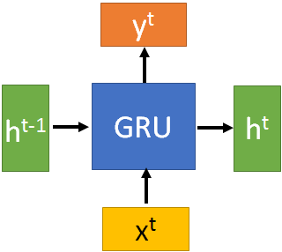
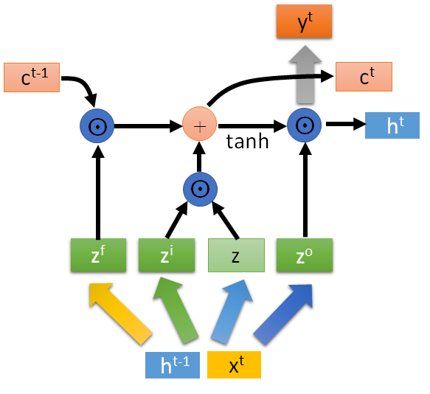





GRU
$$h^{t}=z⨀h^{t−1}+\left(1−z\right)⨀h^{′}$$
y^{t}
h^{t-1}
$$⨀$$
$$＋$$
h^{t}
$$⨀$$
1-
$$⨀$$
reset
update
r
z
h'
h^{t-1}
x^{t}
x^{t}
Notes:
It combines the forget and input gates into a single “update gate.” It also merges the cell state and hidden state, and makes some other changes.
The update gate in GRU is corresponding to the forget gate in LSTM.
In GRU, reset gate does not control the amount of the candidate hidden state independently, it shares some information of update gate and thus has access to important temporal information for phoneme segmentation\cite{chung2014empirical}.

Slide 14
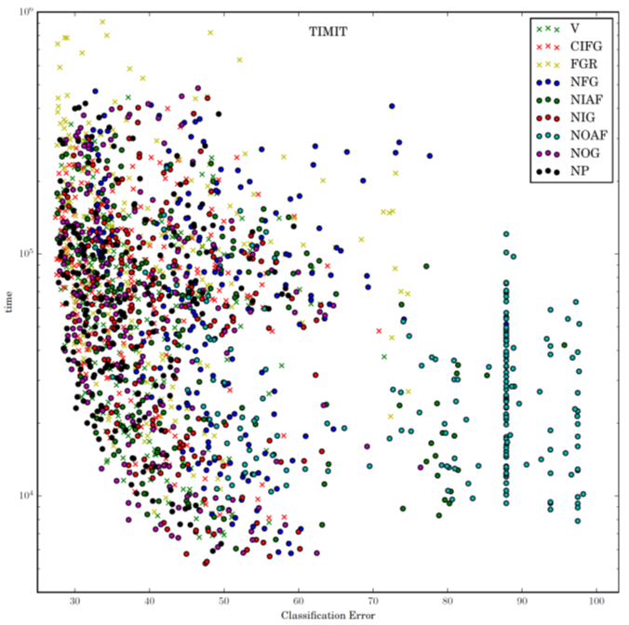
LSTM: A Search Space Odyssey
Notes:
1. No Input Gate (NIG) 2. No Forget Gate (NFG) 3. No Output Gate (NOG) 4. No Input Activation Function (NIAF) 5. No Output Activation Function (NOAF) 6. No Peepholes (NP) 7. Coupled Input and Forget Gate (CIFG) 8. Full Gate Recurrence (FGR)

Slide 15
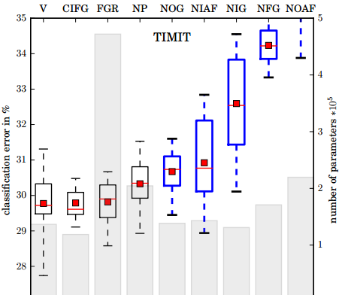
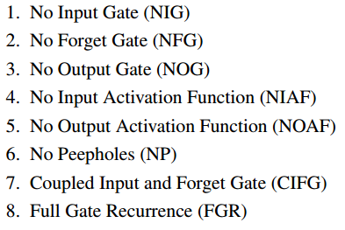
LSTM: A Search Space Odyssey
Standard LSTM works well
Simply LSTM: coupling input and forget gate, removing peephole
Forget gate is critical for performance
Output gate activation function is critical
Notes:
There are more analysis about the interation between the paramters.
Boxes show the range between the 25th and the 75th percentile of the data, while the whiskers indicate the whole range. The red dot represents the mean and the red line the median of the data. The boxes of variants that differ significantly from the vanilla LSTM are shown in blue with thick lines.

Slide 16
Sequence Generation
Notes:
Image
Aaron van den Oord, Nal Kalchbrenner, Koray Kavukcuoglu, Pixel Recurrent Neural Networks, arXiv preprint, 2016
Aaron van den Oord, Nal Kalchbrenner, Oriol Vinyals, Lasse Espeholt, Alex Graves, Koray Kavukcuoglu, Conditional Image Generation with PixelCNN Decoders, arXiv preprint, 2016
Video
Aaron van den Oord, Nal Kalchbrenner, Koray Kavukcuoglu, Pixel Recurrent Neural Networks, arXiv preprint, 2016
Handwriting
Alex Graves, Generating Sequences With Recurrent Neural Networks, arXiv preprint, 2013
Speech
Aaron van den Oord, Sander Dieleman, Heiga Zen, Karen Simonyan, Oriol Vinyals, Alex Graves, Nal Kalchbrenner, Andrew Senior,Koray Kavukcuoglu, WaveNet: A Generative Model for Raw Audio, 2016
Generating a structured object component-by-component based on a given condition

Slide 17
Generation
你
我
他
是
很
x:
0
1
0
0
0
……
0
y:
0
0
0
0.7
0.3
……
0
Sentences are composed of characters/words
Generating a character/word at each time by RNN
y
Distribution over the token
(sampling from the distribution to generate a token)
h
f
h'
x
The token generated at the last time step.
(represented by 1-of-N encoding)
Notes:
E.g. sentences are composed of words
http://youtien.pixnet.net/blog/post/4604096-%E6%8E%A8%E6%96%87%E6%8E%A5%E9%BE%8D%E4%B9%8B%E5%B0%8D%E8%81%AF%E9%81%8A%E6%88%B2

Slide 18



Generation
y¹: P(w|<BOS>)
y²: P(w|<BOS>,床)
y³: P(w|<BOS>,床,前)
Sentences are composed of characters/words
Generating a character/word at each time by RNN
床
前
明
sample, argmax
$$\sim$$
$$\sim$$
$$\sim$$
Until <EOS> is generated
y¹
y²
y³
h⁰
f
h¹
f
h²
f
h³
……
x¹
x²
x³
<BOS>
床
前
Notes:
E.g. sentences are composed of words
http://youtien.pixnet.net/blog/post/4604096-%E6%8E%A8%E6%96%87%E6%8E%A5%E9%BE%8D%E4%B9%8B%E5%B0%8D%E8%81%AF%E9%81%8A%E6%88%B2

Slide 19
Generation
: minimizing cross-entropy
Training data: 春 眠 不 覺 曉
Training
春
眠
不
y¹
y²
y³
h⁰
f
h¹
f
h²
f
h³
……
x¹
x²
x³
<BOS>
春
眠
Notes:
E.g. sentences are composed of words
http://youtien.pixnet.net/blog/post/4604096-%E6%8E%A8%E6%96%87%E6%8E%A5%E9%BE%8D%E4%B9%8B%E5%B0%8D%E8%81%AF%E9%81%8A%E6%88%B2

Slide 20
Generation
Consider as a sentence
blue
red
yellow
……
gray
Train a RNN based on the “sentences”
Images are composed of pixels
Generating a pixel at each time by RNN
red
blue
green
$$\sim$$
$$\sim$$
$$\sim$$
y¹
y²
y³
h⁰
f
h¹
f
h²
f
h³
……
x¹
x²
x³
<BOS>
red
blue
Notes:
(simply replacing words with color)

Slide 21
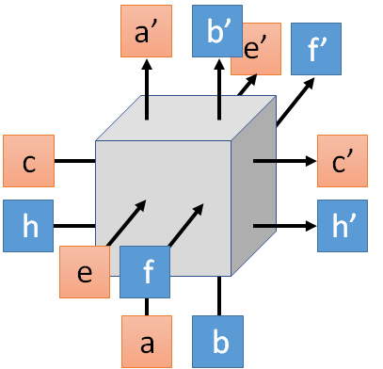
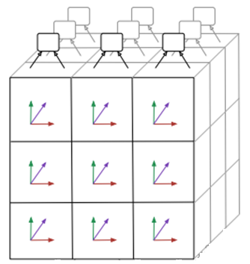
Generation - PixelRNN
3 x 3 images
Images are composed of pixels

Slide 22
Conditional
Sequence Generation
Notes:
Image
Aaron van den Oord, Nal Kalchbrenner, Koray Kavukcuoglu, Pixel Recurrent Neural Networks, arXiv preprint, 2016
Aaron van den Oord, Nal Kalchbrenner, Oriol Vinyals, Lasse Espeholt, Alex Graves, Koray Kavukcuoglu, Conditional Image Generation with PixelCNN Decoders, arXiv preprint, 2016
Video
Aaron van den Oord, Nal Kalchbrenner, Koray Kavukcuoglu, Pixel Recurrent Neural Networks, arXiv preprint, 2016
Handwriting
Alex Graves, Generating Sequences With Recurrent Neural Networks, arXiv preprint, 2013
Speech
Aaron van den Oord, Sander Dieleman, Heiga Zen, Karen Simonyan, Oriol Vinyals, Alex Graves, Nal Kalchbrenner, Andrew Senior,Koray Kavukcuoglu, WaveNet: A Generative Model for Raw Audio, 2016
Generating a structured object component-by-component based on a given condition

Slide 23
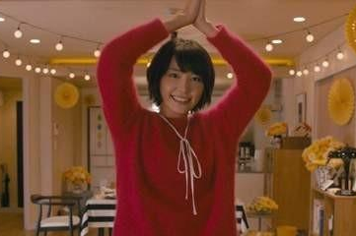


Conditional Generation
We don’t want to simply generate some random sentences.
Generate sentences based on conditions:
Caption Generation
Given condition:
“A young girl is dancing.”
Chat-bot
“Hello”
“Hello. Nice to see you.”
Given condition:
Notes:
Wavnet is the same

Slide 24


Conditional Generation
Represent the input condition as a vector, and consider the vector as the input of RNN generator
Image Caption Generation
A
woman
. (period)
A vector
<BOS>
CNN
……
Input image

Slide 25
Conditional Generation
Sequence-to-sequence learning
Represent the input condition as a vector, and consider the vector as the input of RNN generator
E.g. Machine translation / Chat-bot
machine
learning
. (period)
Information of the whole sentences
機
器
學
習
Encoder
Jointly train
Decoder
Notes:
Video caption is the same

Slide 26

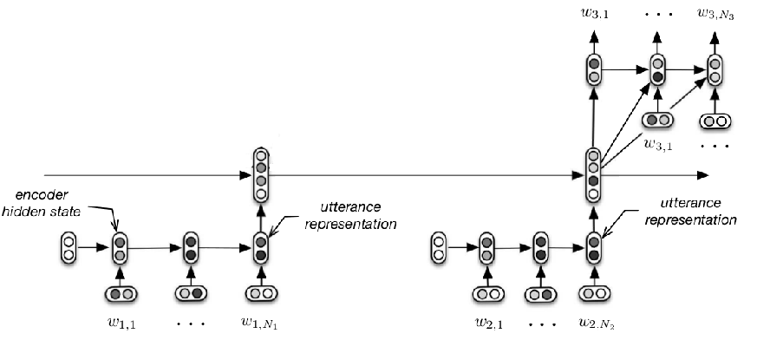
Conditional Generation
M: Hi
M: Hello
Need to consider longer context during chatting
U: Hi
M: Hi
https://www.youtube.com/watch?v=e2MpOmyQJw4
M: Hello
U: Hi
Serban, Iulian V., Alessandro Sordoni, Yoshua Bengio, Aaron Courville, and Joelle Pineau, 2015 "Building End-To-End Dialogue Systems Using Generative Hierarchical Neural Network Models.

Slide 27









Dynamic Conditional Generation
$$c^{1}$$
$$c^{2}$$
machine
learning
. (period)
$$h^{1}$$
$$h^{2}$$
$$h^{3}$$
$$h^{4}$$
機
器
學
習
$$c^{1}$$
$$c^{2}$$
$$c^{3}$$
Encoder
Decoder
Notes:
Video caption is the same

Slide 28










Machine Translation
$$α$$
Jointly learned with other part of the network
match
Attention-based model
$$h$$
$$z$$
$$α_{0}^{1}$$
match
What is ?
match
$$z^{0}$$
Design by yourself
Cosine similarity of z and h
$$h^{1}$$
$$h^{2}$$
$$h^{3}$$
$$h^{4}$$
Small NN whose input is z and h, output a scalar
機
器
學
習
$α=h^{T}Wz$
Notes:
Word vector

Slide 29














Machine Translation
Attention-based model
machine
$$c^{0}$$
0.5
$${\hat{α}}_{0}^{1}$$
0.5
$${\hat{α}}_{0}^{2}$$
0.0
$${\hat{α}}_{0}^{3}$$
0.0
$${\hat{α}}_{0}^{4}$$
$$z^{0}$$
$$z^{1}$$
softmax
$$α_{0}^{1}$$
$$α_{0}^{2}$$
$$α_{0}^{3}$$
$$α_{0}^{4}$$
$$c^{0}$$
Decoder input
$$h^{1}$$
$$h^{2}$$
$$h^{3}$$
$$h^{4}$$
$$c^{0}=\sum{{\hat{α}}_{0}^{i}h^{i}}$$
機
器
學
習
$$=0.5h^{1}+0.5h^{2}$$
Notes:
Word vector

Slide 30

Machine Translation
Attention-based model
machine
$$α_{1}^{1}$$
match
$$z^{0}$$
$$z^{1}$$
$$c^{0}$$
$$h^{1}$$
$$h^{2}$$
$$h^{3}$$
$$h^{4}$$
機
器
學
習
Notes:
Word vector

Slide 31













Machine Translation
Attention-based model
machine
learning
$$c^{1}$$
0.0
$${\hat{α}}_{1}^{1}$$
0.0
$${\hat{α}}_{1}^{2}$$
0.5
$${\hat{α}}_{1}^{3}$$
0.5
$${\hat{α}}_{1}^{4}$$
$$z^{0}$$
$$z^{1}$$
$$z^{2}$$
softmax
$$α_{1}^{1}$$
$$α_{1}^{2}$$
$$α_{1}^{3}$$
$$α_{1}^{4}$$
$$c^{0}$$
$$c^{1}$$
$$h^{1}$$
$$h^{2}$$
$$h^{3}$$
$$h^{4}$$
$$c^{1}=\sum{{\hat{α}}_{1}^{i}h^{i}}$$
機
器
學
習
$$=0.5h^{3}+0.5h^{4}$$
Notes:
Word vector

Slide 32

Machine Translation
Attention-based model
machine
learning
……
$$α_{2}^{1}$$
……
match
$$z^{0}$$
$$z^{1}$$
$$z^{2}$$
$$c^{0}$$
$$c^{1}$$
……
$$h^{1}$$
$$h^{2}$$
$$h^{3}$$
$$h^{4}$$
The same process repeat until generating
機
器
學
習
<EOS>
Notes:
Word vector

Slide 33
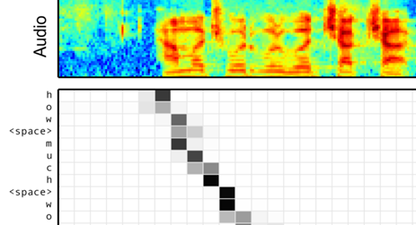
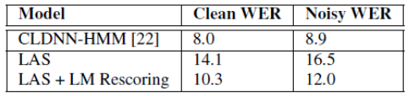
Speech Recognition
William Chan, Navdeep Jaitly, Quoc V. Le, Oriol Vinyals, “Listen, Attend and Spell”, ICASSP, 2016
Notes:
土撥鼠
撥

Slide 34
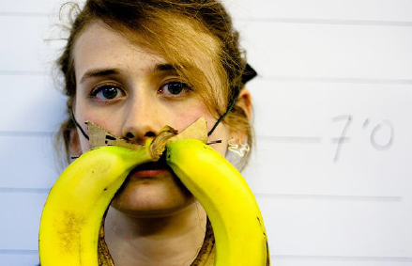

Image Caption Generation
A vector for each region
match
$$z^{0}$$
0.7
CNN
filter
filter
filter
filter
filter
filter
filter
filter
filter
filter
filter
filter

Slide 35

Image Caption Generation
Word 1
A vector for each region
$$z^{0}$$
$$z^{1}$$
CNN
filter
filter
filter
weighted sum
filter
filter
filter
0.7
0.1
0.1
0.1
0.0
0.0
filter
filter
filter
filter
filter
filter

Slide 36

Image Caption Generation
Word 1
Word 2
A vector for each region
$$z^{0}$$
$$z^{1}$$
$$z^{2}$$
weighted sum
CNN
filter
filter
filter
filter
filter
filter
0.0
0.8
0.2
0.0
0.0
0.0
filter
filter
filter
filter
filter
filter

Slide 37
Image Caption Generation
Kelvin Xu, Jimmy Ba, Ryan Kiros, Kyunghyun Cho, Aaron Courville, Ruslan Salakhutdinov, Richard Zemel, Yoshua Bengio, “Show, Attend and Tell: Neural Image Caption Generation with Visual Attention”, ICML, 2015
Notes:
Caption generation story like
How to do story like !!!!!!!!!!!!!!!!!!
http://www.cs.toronto.edu/~mbweb/
https://github.com/ryankiros/neural-storyteller

Slide 38
Image Caption Generation
Kelvin Xu, Jimmy Ba, Ryan Kiros, Kyunghyun Cho, Aaron Courville, Ruslan Salakhutdinov, Richard Zemel, Yoshua Bengio, “Show, Attend and Tell: Neural Image Caption Generation with Visual Attention”, ICML, 2015
Notes:
滑板相關詞
skateboarding
查看全部
skateboard
¹ Dr.eye譯典通
KK [ˋsket͵bord] DJ [ˋskeitbɔ:d]

Slide 39
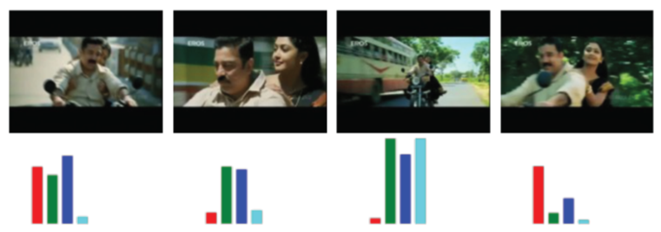
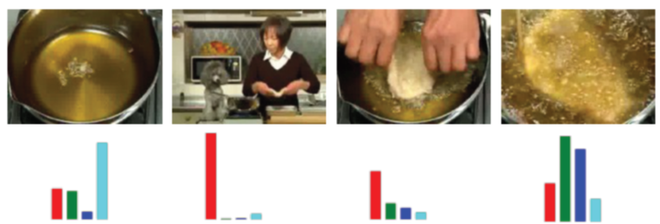

Li Yao, Atousa Torabi, Kyunghyun Cho, Nicolas Ballas, Christopher Pal, Hugo Larochelle, Aaron Courville, “Describing Videos by Exploiting Temporal Structure”, ICCV, 2015
Notes:
Another application is summarization

Slide 40
Tips for Generation
Notes:
Beam search
Safe
whole
http://www.thespermwhale.com/jaseweston/ram/
MMI/RL on chat-bot

Slide 41
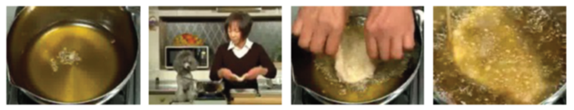



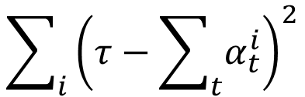














Attention
Kelvin Xu, Jimmy Ba, Ryan Kiros, Kyunghyun Cho, Aaron Courville, Ruslan Salakhutdinov, Richard Zemel, Yoshua Bengio, “Show, Attend and Tell: Neural Image Caption Generation with Visual Attention”, ICML, 2015
component
$$α_{t}^{i}$$
time
Bad Attention
$$α_{1}^{1}$$
$$α_{2}^{1}$$
$$α_{3}^{1}$$
$$α_{4}^{1}$$
$$α_{1}^{2}$$
$$α_{2}^{2}$$
$$α_{3}^{2}$$
$$α_{4}^{2}$$
$$α_{1}^{3}$$
$$α_{2}^{3}$$
$$α_{3}^{3}$$
$$α_{4}^{3}$$
$$α_{1}^{4}$$
$$α_{2}^{4}$$
$$α_{3}^{4}$$
$$α_{4}^{4}$$
w₁
w₂
(woman)
w₃
w₄
(woman)
…… no cooking
Good Attention: each input component has approximately the same attention weight
$$\sum_{i}{{\left(τ−\sum_{t}{α_{t}^{i}}\right)}^{2}}$$
E.g. Regularization term:
For each component
Over the generation

Slide 42

Mismatch between Train and Test
Reference:
Training
A
B
B
$$C=\sum_{t}{C_{t}}$$
A
A
A
B
B
B
Minimizing cross-entropy of each component
<BOS>
A
: condition
B

Slide 43
Mismatch between Train and Test
Generation
B
A
A
We do not know the reference
A
A
A
Testing: The inputs are the outputs of the last time step.
B
B
B
Training: The inputs are reference.
<BOS>
A
Exposure Bias
B
Notes:
Exposure Bias
暴露；暴曬

Slide 44
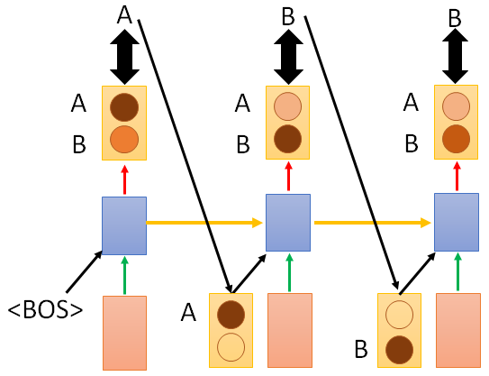

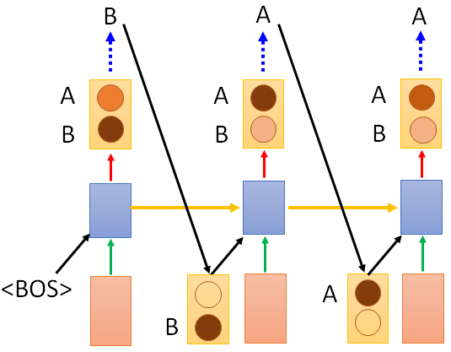
B
A
B
A
A
A
B
B
A
B
A
B
One step wrong
A
B
B
A
B
A
A
A
B
B
A
B
A
B
May be totally wrong
Never explore ……
A
B
一步錯，步步錯

Slide 45
Modifying Training Process?
Reference
When we try to decrease the loss for both steps 1 and 2 …..
A
B
B
B
A
A
A
A
A
Training is matched to testing.
B
B
B
In practice, it is hard to train in this way.
A
A
B

Slide 46

Scheduled Sampling
A
Reference
B
B
A
A
A
A
B
B
B
A
B
from model
from model
A
From reference
From reference
B

Slide 47
Beam Search
The green path has higher score.
Not possible to check all the paths
A
B
A
B
A
A
B
B
0.4
0.6
0.9
0.4
A
B
0.6
A
B
0.9
0.6
A
B
0.4

Slide 48
Beam Search
Keep several best path at each step
Beam size = 2
A
B
A
B
A
A
B
B
A
B
A
B
A
B

Slide 49
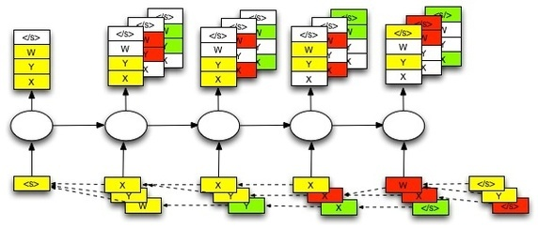
Beam Search
The size of beam is 3 in this example.
https://github.com/tensorflow/tensorflow/issues/654#issuecomment-169009989

Slide 50

Better Idea?
I am ……
I are ……
You are ……
You am ……
you
are
am ≈ are
B
A
high
score
you
A
I ≈ you
A
A
A
A
B
B
B
B
<BOS>
<BOS>
A
B
B
you
I ≈ you

Slide 51
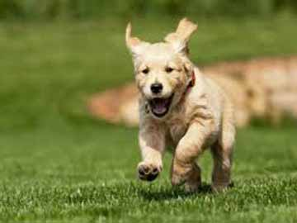

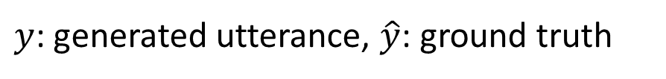
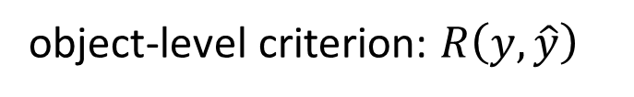
Object level v.s. Component level
Minimizing the error defined on component level is not equivalent to improving the generated objects
Ref: The dog is running fast
$$C=\sum_{t}{C_{t}}$$
A cat a a a
The dog is is fast
Cross-entropy of each step
The dog is running fast
Optimize object-level criterion instead of component-level cross-entropy.
object-level criterion: $R\left(y,\hat{y}\right)$
Gradient Descent?
$y$: generated utterance, $\hat{y}$: ground truth
Notes:
Can we do Gradient descent?

Slide 52

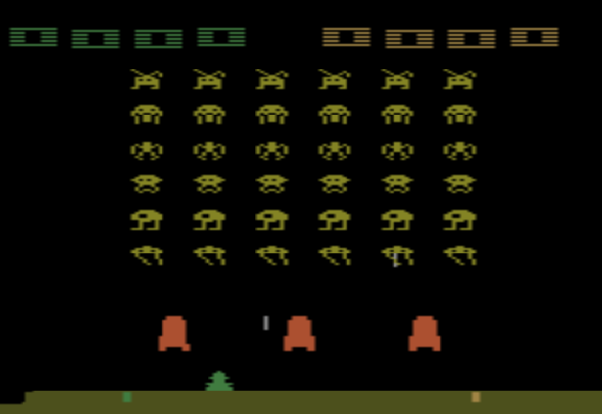

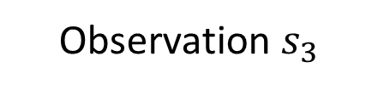
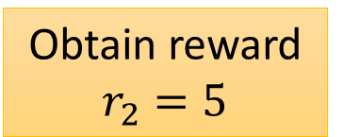
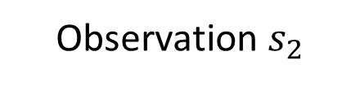
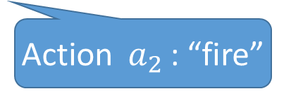
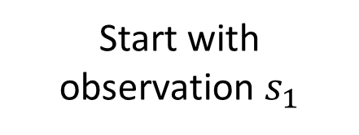
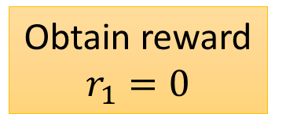
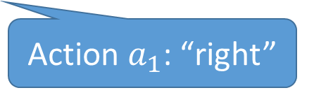
Reinforcement learning?
Start with observation $s_{1}$
Observation $s_{2}$
Observation $s_{3}$
Obtain reward $r_{1}=0$
Obtain reward $r_{2}=5$
Action $a_{1}$: “right”
Action $a_{2}$: “fire”
(kill an alien)
Notes:
SEQUENCE LEVEL TRAINING

Slide 53



Reinforcement learning?
$$reward:$$
R(“BAA”, reference)
$r=0$
$r=0$
Action taken
B
A
A
A
A
A
Actions set
B
B
B
<BOS>
A
observation
B
Marc'Aurelio Ranzato, Sumit Chopra, Michael Auli, Wojciech Zaremba, “Sequence Level Training with Recurrent Neural Networks”, ICLR, 2016
The action we take influence the observation in the next step

